Slide 1

Lists, Stacks, and Queues
CS 2321
Data Structures and Algorithms
Dr. Mahmoud Hassaballah

Slide 2
Outlines
Objectives
Abstract Data Types (ADTs)
The List ADT
Simple Array Implementation of Lists
Simple Linked Lists
3. The Stack ADT
Stack Model
Implementation of Stacks
Applications
4. The Queue ADT
Queue Model
Implementation of Queues
Applications of Queues

Slide 3
Objectives
We will:
Introduce the concept of Abstract Data Types (ADT).
Show how to efficiently perform operations on lists.
Introduce the stack and queue ADTs.

Slide 4
1. Abstract Data Types (ADTs)

Slide 5
Abstract Data Types (ADTs)
Abstract Data Types (ADT): A set of objects + a set of operations
Example: integer
set of whole numbers
operations: +, -, *, /
Abstract Data Types (ADT) is a logical view of the data objects together with specifications of the operations required to create and manipulate them.
Describe an algorithm – pseudocode
Describe a data structure – ADT

Slide 6
2. The List ADT

Slide 7
The List ADT: Definition
List is a sequence of zero or more elements
A₀, A₁, A₂, … A_{N-1}
N : size (length) of the list
If the size is zero, then empty list
A₀: first element
A_{N-1}: last element
A_{i} : position i
A_{i-1}: precedes (predecessor) A_{i} (i > 0)
A_{i+1}: follows (successor) A_{i} (i < N)
We will assume, to simplify matters, that the elements in the list are integers, but in general, arbitrarily complex elements are allowed.

Slide 8
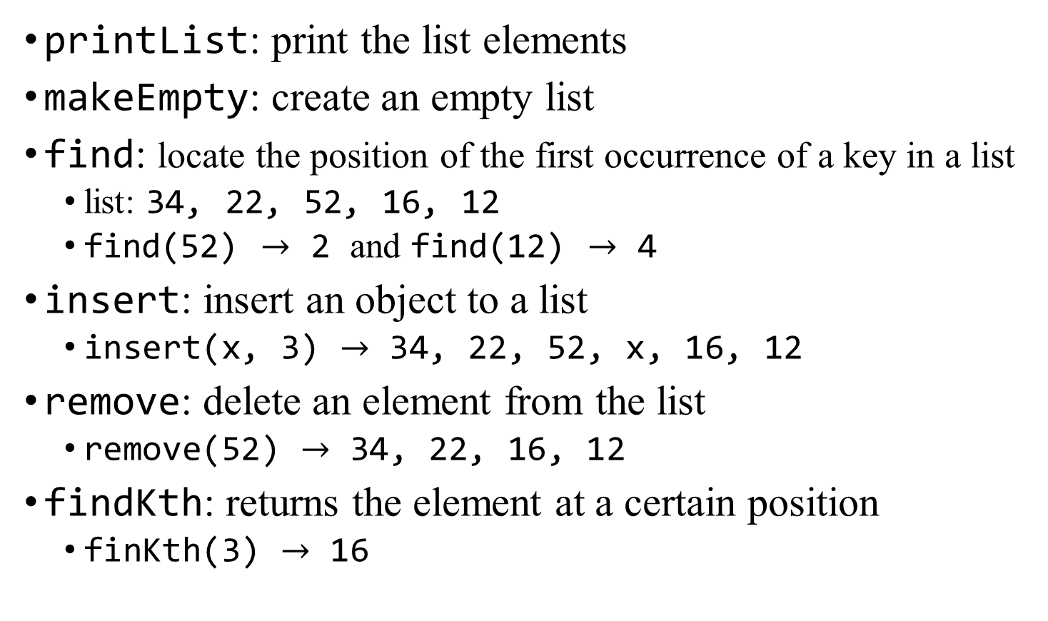
The List ADT: Operations
printList: print the list elements
makeEmpty: create an empty list
find: locate the position of the first occurrence of a key in a list
list: 34, 22, 52, 16, 12
find(52) $→$ 2 and find(12) $→$ 4
insert: insert an object to a list
insert(x, 3) $→$ 34, 22, 52, x, 16, 12
remove: delete an element from the list
remove(52) $→$ 34, 22, 16, 12
findKth: returns the element at a certain position
finKth(3) $→$ 16

Slide 9
The List ADT: Operations and standard implementations
Each operation associated with the ADT is implemented by one or more routines
Five standard implementations for the list ADT:
1. Array,
2. Linked List,
3. Doubly Linked List,
4. Circular Linked Lists, and
5. Doubly Circular Linked Lists.

Slide 10
The List ADT: Simple Array Implementation of Lists
If we use array, elements are stored in contiguous array positions
Requires an estimate of the maximum size of the list, waste space.
1
First element
2
Second element
List
Last
Last element
N+1
Empty
maxlength

Slide 11
The List ADT: Simple Array Implementation of Lists
printList and find: linear time O(N)
findKth: Constant time O(1)
insert and remove: slow – the worst case is O (N )
e.g. insert at position 0 (making a new element) requires first pushing the entire array down one spot to make room
e.g. remove at position 0 requires shifting all the elements in the list up one
On average, half of the lists needs to be moved for either operation, so linear time is still required O (N ).
Building a list by N successive inserts would require quadratic time (Why?).

Slide 12
The List ADT: Simple Linked Lists
Because the running time for insertions and deletions is so slow and the list size must be known in advance, simple arrays are generally not used to implement lists.
In order to avoid the linear cost of insertion and deletion, we need to ensure that the list is not stored contiguously.
A linked list is a series of structures (nodes), which are not necessarily adjacent in memory.

Slide 13
The List ADT: Simple Linked Lists
Linked lists are more complex to code and manage than arrays, but they have some distinct advantages:
1. Dynamic: a linked list can easily grow and shrink in size.
We don’t need to know how many nodes will be in the list. They are created in memory as needed.
2. Easy and fast insertions and deletions
To insert or delete an element in an array, we need to copy to temporary variables to make room for new elements or close the gap caused by deleted elements.
With a linked list, no need to move other nodes. Only need to reset some pointers.

Slide 14
The List ADT: Simple Linked Lists
The following figure shows the general idea of a linked list. The list contains five structures
Each structure contains at least
The element: a piece of data (any type)
The next pointer: a pointer to the next structure in the list
The last node’s next pointer points to nullPtr.
ANSI C specifies that nullPtr is zero.
A₀
A₁
A₂
A₃
A₄
Node
Data
Pointer

Slide 15
The List ADT: Simple Linked Lists
The following figure shows actual representation of a linked list.
The list contains five structures, which happen to reside in memory locations 1000, 800, 712, 992 and 692 respectively.
The next pointer in the first structure has the value 800, which provides the indication of where the second structure is.
We will draw pointers with arrows, because they are more illustrative.
A₀
800
A₁
712
A₂
992
A₃
692
A₄
0
1000
800
712
992
692

Slide 16
The List ADT: Simple Linked Lists
In order to access this list, we need to know where the first cell can be founded. A pointer variable can be used for this purpose called head node.
The head is extra node in a linked list that holds no data but serves to satisfy the requirement that every node have a previous node.
Head
Predecessor
of X
Successor
of X
Node X

Slide 17
The List ADT: Simple Linked Lists
To execute printList(L) or find(L, key), we merely pass a pointer to the first element in the list and then traverse the list by following the next pointers: liner time
findKth(L, i) takes O (i ) time and works by traversing down the list in the obvious manner.
The remove command can be executed in one pointer change.
The insert command requires obtaining a new cell from the system then executing two pointer maneuvers.
A₀
A₁
A₂
A₃
A₄
A₀
A₁
A₂
A₃
A₄
X

Slide 18
The List ADT: Doubly Linked Lists
Each node points to not only successor but the predecessor
There are two nullPtr: at the first and last nodes in the list
Advantage: given a node, it is easy to visit its predecessor. Convenient to traverse lists backwards
Also we create an extra node at the end of the list to represent the endmarker known as a tail node.
A₁
A₂
A₃
A₄
A₅
Head
Previous pointer
Next pointer
Tail

Slide 19
The List ADT: Circular Linked Lists
The last node points to the first node of the linked list.
This can be done with or without a header. If the header is present, the last cell points to it.
How do we know when we have finished traversing the list? (Tip: check if the pointer of the current node is equal to the head.)
A₁
A₂
A₃
A₄
A₅
A₁
A₂
A₃
A₄
A₅
Head

Slide 20
The List ADT: Circular Doubly Linked Lists
In the double linked list, the first node’s previous pointer points to the last node.
also the last node’s next pointer points to the first node.
A₁
A₂
A₃
A₄
A₅

Slide 21
3. The Stack ADT

Slide 22

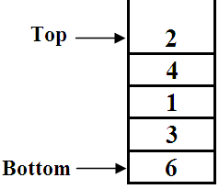
The Stack ADT: Stack Model
A stack is a list with the restriction that insertions and deletions can only be performed in only one position
this position is called the top of the list
the other end is called the bottom of the list
Fundamental operations:
Push: Equivalent to an insert
Pop: Deletes the most recently inserted element
Top: Examines the most recently inserted element

Slide 23
The Stack ADT: Stack Model
Stacks are less flexible, but are more efficient and easy to implement
Stacks are known as LIFO (Last In First Out) lists. The last element inserted will be the first to be retrieved
Push
Push
Push
Push
Push
Pop
B
A
C
B
A
D
C
B
A
E
D
C
B
A
top
D
C
B
A
top
top
top
top
A
top

Slide 24
The Stack ADT: Operations
(1) createStack
Create an empty stack
(2) push
Add an element to the top of the stack
(3) pop
Remove the element at the top of the stack
(4) isEmpty
Test whether a stack is empty
(5) top
Returning the value of the top element

Slide 25
The Stack ADT: Implementation
Any list implementation could be used to implement a stack
Arrays (static: the size of stack is given initially)
Linked lists (dynamic: never become full)

Slide 26
The Stack ADT: Applications
Applications related to computer science:
Program execution stack (keeping track of function calls)
Parenthesis balancing
Evaluating postfix expressions
Infix to postfix conversion

Slide 27
The Stack ADT: Application 1
Balancing Symbols
To check that every right parentheses, bracket, comment starter and brace must correspond to its left counterpart, e.g. [( )] is legal, but [( ] ) is illegal

Slide 28
The Stack ADT: Application 1
Algorithm (Balancing Symbols)
(1) Make an empty stack.
(2) Read characters until end of file:
i. If the character is an opening symbol, push it onto the stack.
ii. If it is a closing symbol, then if the stack is empty, report an error.
iii. Otherwise, pop the stack. If the symbol popped is not the
corresponding opening symbol, then report an error.
(3) At end of file, if the stack is not empty, report an error.

Slide 29
The Stack ADT: Application1
Example 1: Check the balance for the following sentence:
A * ( B + C ) * D + E [ I ]
Input Stack
empty
A empty
* empty
( (
B (
+ (
C (
) empty
* empty
D empty
+ empty
E empty
[ [
I [
] empty
Since stack is empty, then the expression is balanced.

Slide 30
The Stack ADT: Application1
Example 2: Check the balance for the following sentence:
A * ( B + C * D + E [ I ])
Input Stack
empty
A empty
* empty
( (
B (
+ (
C (
* (
D (
+ (
E (
[ [ (
I [ (
] (
) empty
Since stack is empty, then the expression is balanced.

Slide 31
The Stack ADT: Application 1
Example 3: Check the balance for the following sentence:
A * ( B + C * D + E [ I ]
Input Stack
empty
A empty
* empty
( (
B (
+ (
C (
* (
D (
+ (
E (
[ [ (
I [ (
] (
Since stack is not empty, there is an error.

Slide 32
The Stack ADT: Application 1
Example 4: Check the balance for the following sentence:
A * ( B + C * D + E [ I )]
Input Stack
empty
A empty
* empty
( (
B (
+ (
C (
* (
D (
+ (
E (
[ [ (
I [ (
) (
Since ‘)’ and ‘[‘ have different types, there is an error.

Slide 33
The Stack ADT: Application 1
Example: Check the balance for the following
A * ( B + E [ I ) + C ] * D
Input Stack
empty
A empty
* empty
( (
B (
+ (
E (
[ [ (
I [ (
) (
Since the symbol popped ‘[‘ is not correspond to the input opening symbol ‘)’, then report an error

Slide 34
The Stack ADT: Application 2
Evaluation of Postfix Expressions
Calculate the infix expression
4.99 * 1.06 + 5.99 + 6.99 * 1.06
need to know the precedence rules
Postfix expression
4.99 1.06 * 5.99 + 6.99 1.06 * +

Slide 35
The Stack ADT: Application 2
Algorithm (Evaluation of Postfix Expressions)
Use stack to evaluate postfix expressions
1. When a number is seen, it is pushed onto the stack.
2. When an operator is seen, the operator is applied to the two numbers that are popped from the stack.
3. The result is pushed onto the stack.
The time to evaluate a postfix expression is O (N )

Slide 36
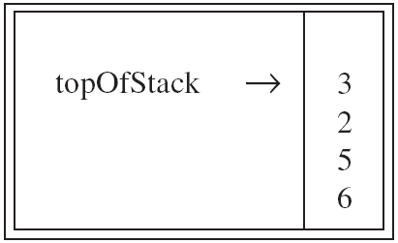
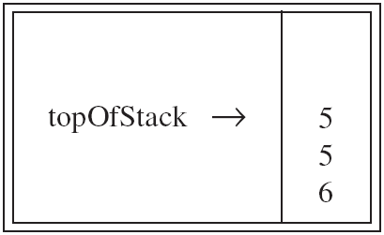
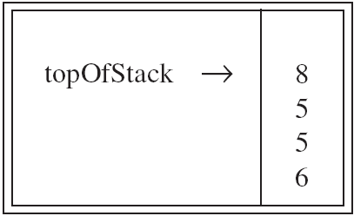
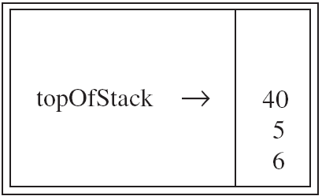
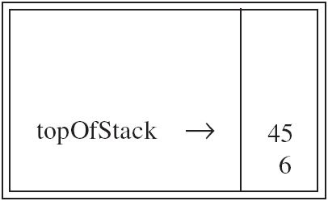
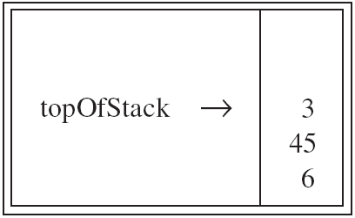
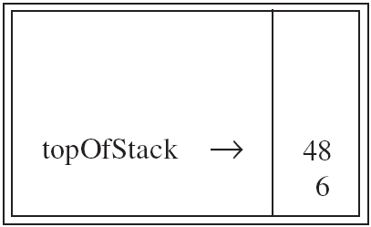
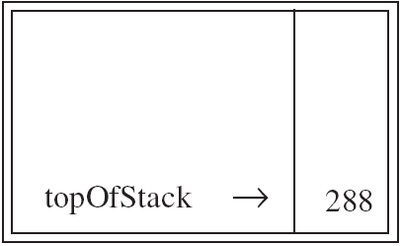
The Stack ADT: Application 2
Example: Using the stack to evaluate postfix expressions
6 5 2 3 + 8 * + 3 + *

Slide 37
The Stack ADT: Application 2
Example: Using the stack to evaluate postfix expressions
6 5 2 3 + 8 * + 3 + *
Input Stack
empty
6 6
5 6 5
2 6 5 2
3 6 5 2 3
+ 6 5 5
8 6 5 5 8
* 6 5 40
+ 6 45
3 6 45 3
+ 6 48
* 288
The expression value

Slide 38
The Stack ADT: Application 3
Infix to Postfix Conversion
Expression:
Operands: numbers
Operators: +, -, *, /
Parenthesis: ( )
Precedence:
'(' and ')' have the highest precedence
'*' and '/ 'have lower precedence than '(' and ')'
'+' and '-' have lower precedence than '*' and '/'

Slide 39
The Stack ADT: Application 3
Algorithm (Infix to Postfix Conversion)
(1) Initialize a stack to empty.
(2) Read a symbol
(2.1) If it is an operand, place onto the output.
(2.2) If it is an operator
(a) If it is a right parenthesis, then pop the stack, write symbols, until a left parenthesis is encountered.
Remark: The '(' is popped, but not written as output.
(b) If it is any other symbol, such as '+', '*', '(', pop entries from the stack until an entry of lower priority is found, or '(' is found. When the popping is done, push the operator onto the stack.
Remark: If '(' is found, don’t pop it.
(3) Go to step (2).
(4) If read the end of input, pop the stack until it is empty,
writing symbols onto the output.

Slide 40
The Stack ADT: Application 3
Example: Convert the following infix expression into postfix
A * B + C * D
Input Stack Output
empty
A empty A
* * A
B * A B
+ + A B *
C + A B * C
* + * A B * C
D + * A B * C D
pop stack A B * C D * +
The postfix form

Slide 41
The Stack ADT: Application 3
Example: Convert the following infix expression into postfix
A + B * C + ( D * E + F ) * G
Input Stack Output
empty
A empty A
+ + A
B + A B
* + * A B
C + * A B C
+ + A B C * +
( + ( A B C * +
D + ( A B C * + D
* + ( * A B C * + D
E + ( * A B C * + D E
+ + ( + A B C * + D E *
F + ( + A B C * + D E * F
) + A B C * + D E * F +
* + * A B C * + D E * F +
G + * A B C * + D E * F + G
pop stack A B C * + D E * F + G * +
The postfix form

Slide 42
4. The Queue ADT

Slide 43
The Queue ADT: Model
Like a stack, a queue is also a list. However, with a queue, insertion is done at one end, while deletion is performed at the other end.
Accessing the elements of queues follows a First In, First Out (FIFO) order.
Like check-out lines in a store, a queue has a front and a rear.
Basic operations:
Enqueue: insert an element at the rear of the list
Dequeue: delete the element at the front of the list
Remove (dequeue)
Insert (enqueue)
front
rear

Slide 44
The Queue ADT: Array Implementation
Array Implementation of Queues
When an item is enqueued, make the rear index move forward.
When an item is dequeued, the front index moves by one element towards the back of the queue (thus removing the front item, so no copying to neighboring elements is needed).
The problem here is that the rear index cannot move beyond the last element in the array.
(front)
XXXXOOOOO (rear)
OXXXXOOOO (after 1 dequeue, and 1 enqueue)
OOXXXXXOO (after another dequeue, and 2 enqueues)
OOOOXXXXX (after 2 more dequeues, and 2 enqueues)

Slide 45
The Queue ADT: Array Implementation
Implementation using Circular Array
When an element moves past the end of a circular array, it wraps around to the beginning, e.g.
OOOOO7963 → 4OOOO7963 (after enqueue(4)

Slide 46
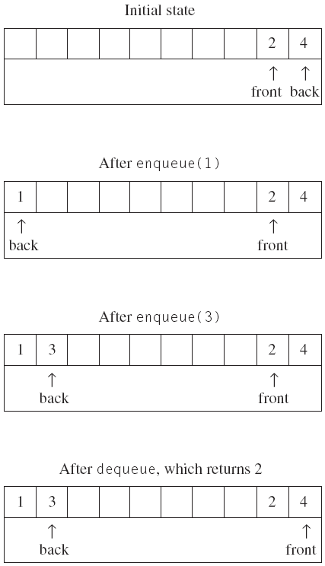
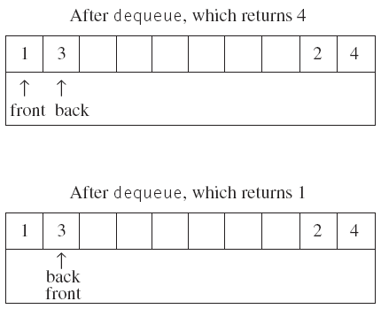
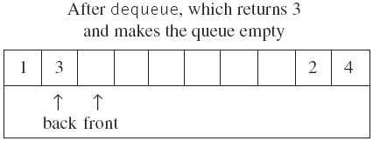
The Queue ADT: Array Implementation

Slide 47
The Queue ADT: Array Implementation
Empty queue
rear = front - 1
Full queue
Use a boolean variable to say explicitly whether the queue is empty or not
Make the array of size N+1 and only allow N elements to be stored
Use a counter of the number of elements in the queue

Slide 48
The Queue ADT: Applications
Real life
Real-life waiting lines. Like customers standing in a check-out line in a store, the first customer in is the first customer served.
More applications related to computer science
Print jobs
Computer networks
OS

